Slide 1


Citi Bike Data Science In New York City Minjae Lee 12/29/2020

Slide 2

Citi Bike Operation
Bike/Scooter sharing is a new p2p consumer business model
Dockstation version in US
12000 citibikes, more than 750 dock stations in NYC
Operated by motivate, gains monopoly to operate shared-bikes in NYC
1. Individual → Subscriber, Customer
2. Corporate

Slide 3
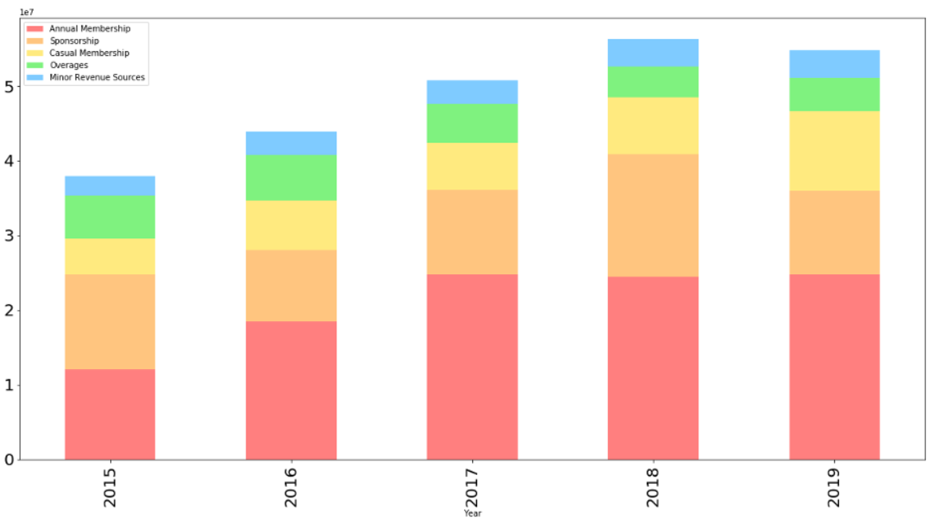
Purpose
The growth of Citi Bike is stagnant due to many sharing competitors. To find out which factors are most important and affect the increase in Subscribers, the most important factor for business growth, and to provide alternatives.

Slide 4
Data
Citi Bike Monthly Trip Data
- Trip data including trip duration, Bike ID,
start and end time, start and end locations,
user type, gender, age
- 5% of each month data
Period of Data
- January 2019 ~ December 2019
Data
- 1,027,583 data and 15 features

Slide 5
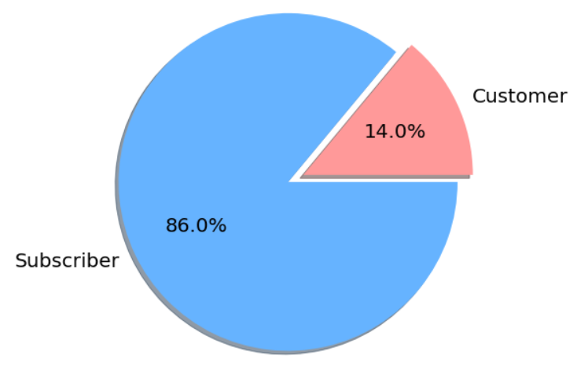
User Type Distribution

Slide 6
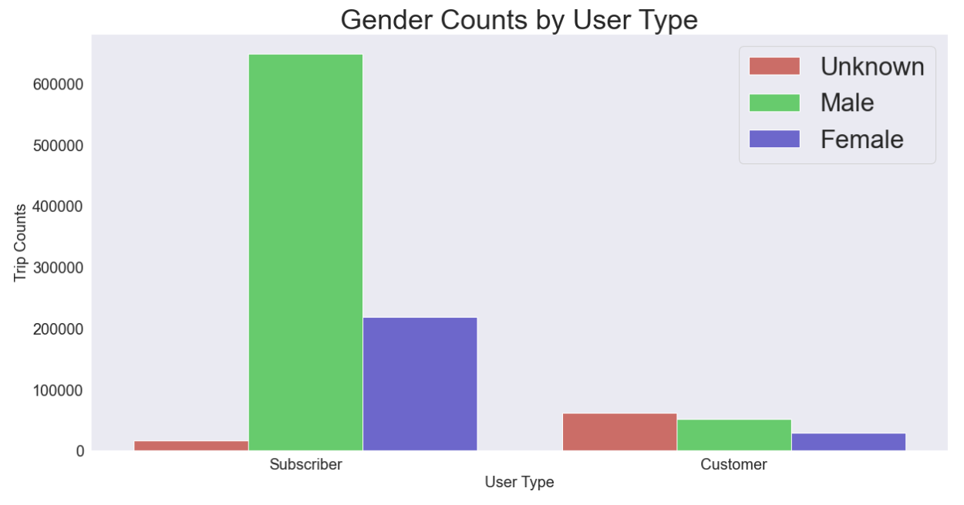
Gender Counts by
User Type

Slide 7
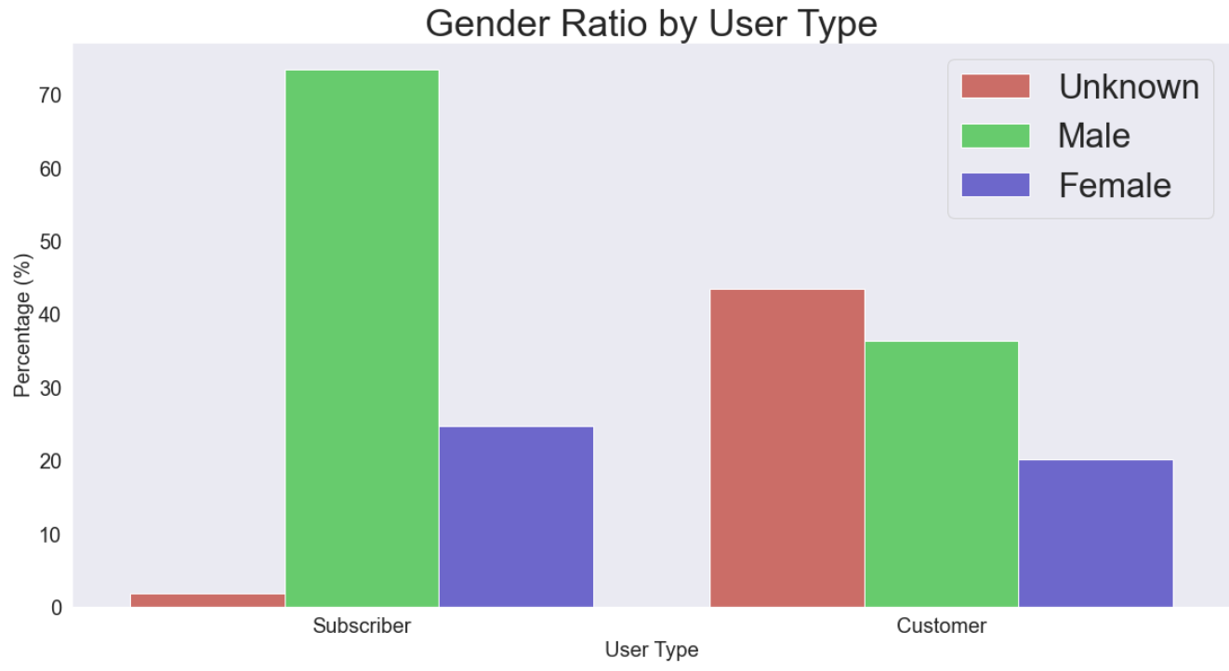
Gender Ratio by
User Type

Slide 8
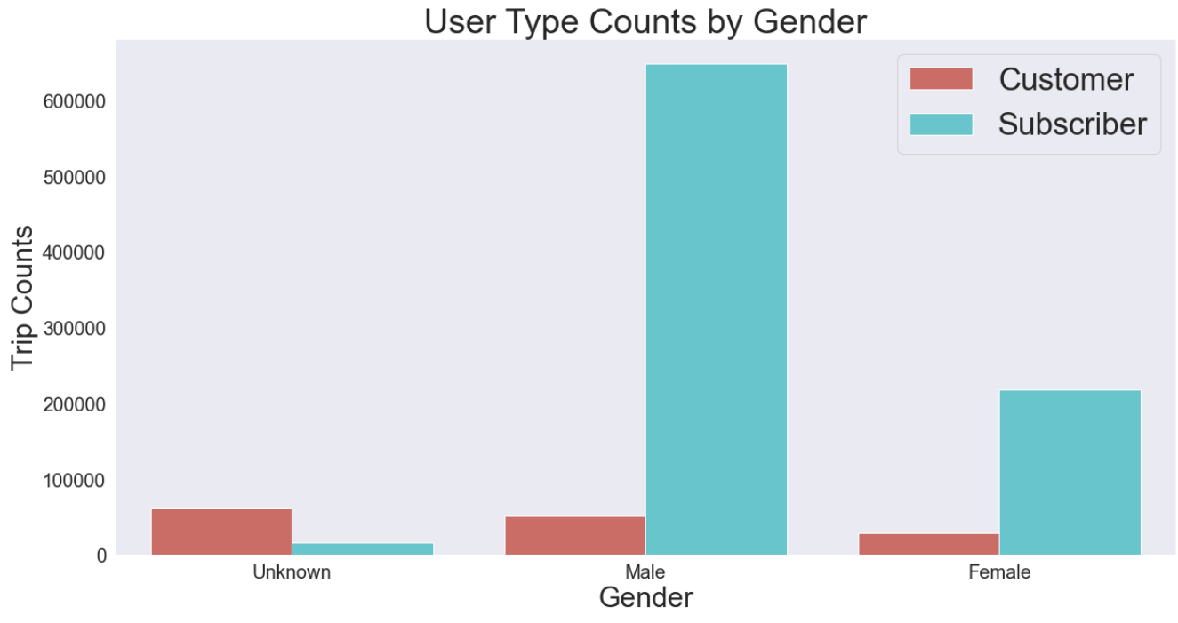
User Type Counts by
User Type

Slide 9
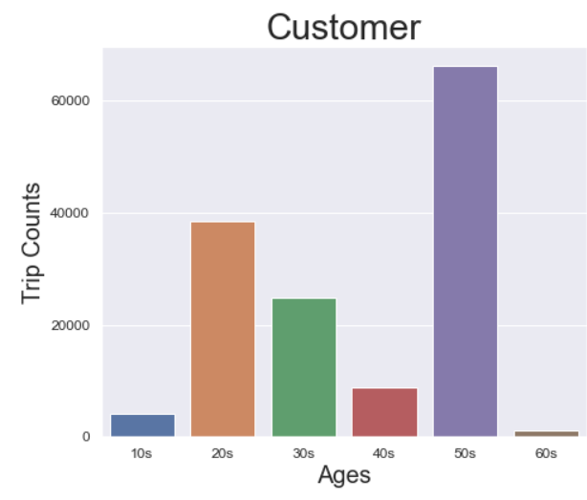
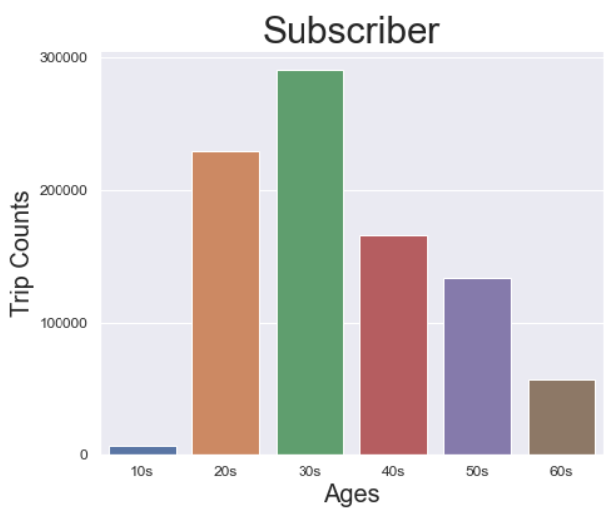
Age Distribution by
User Type

Slide 10
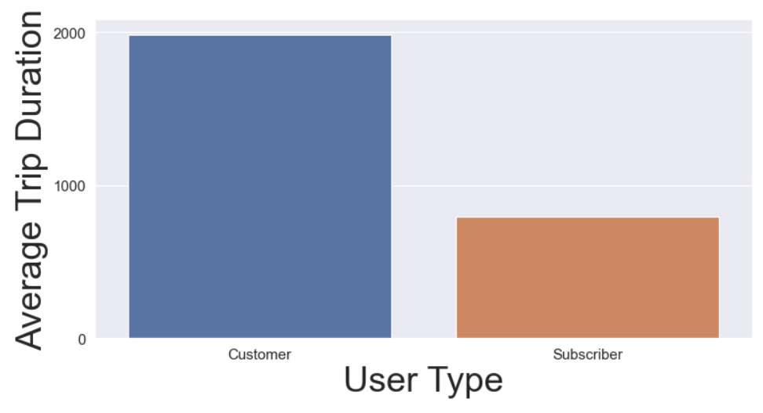
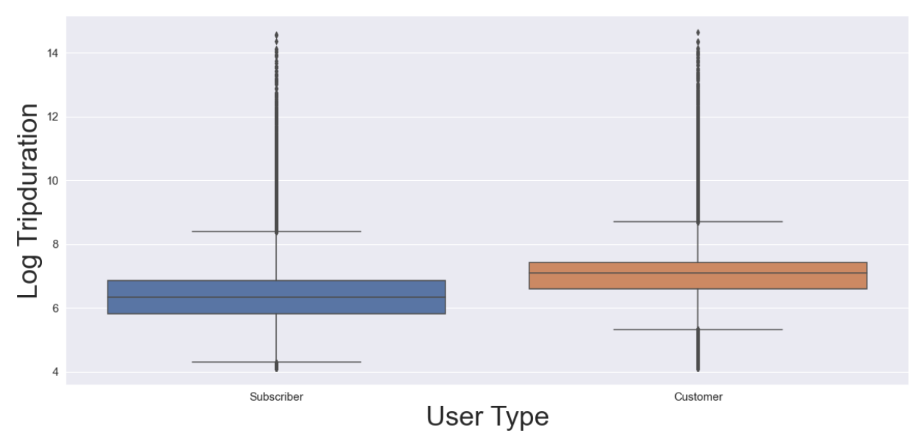
Trip Duration by
User Type

Slide 11
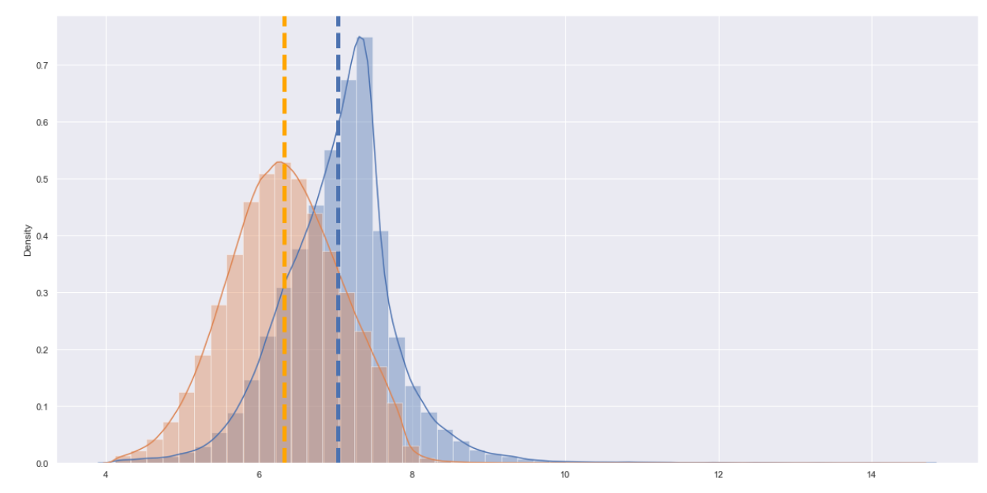

Trip Duration by
User Type

Slide 12
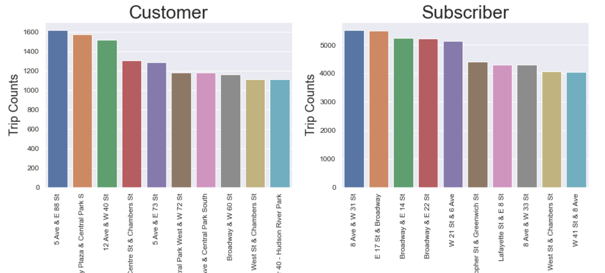
Most Popular Start Stations by User Type

Slide 13
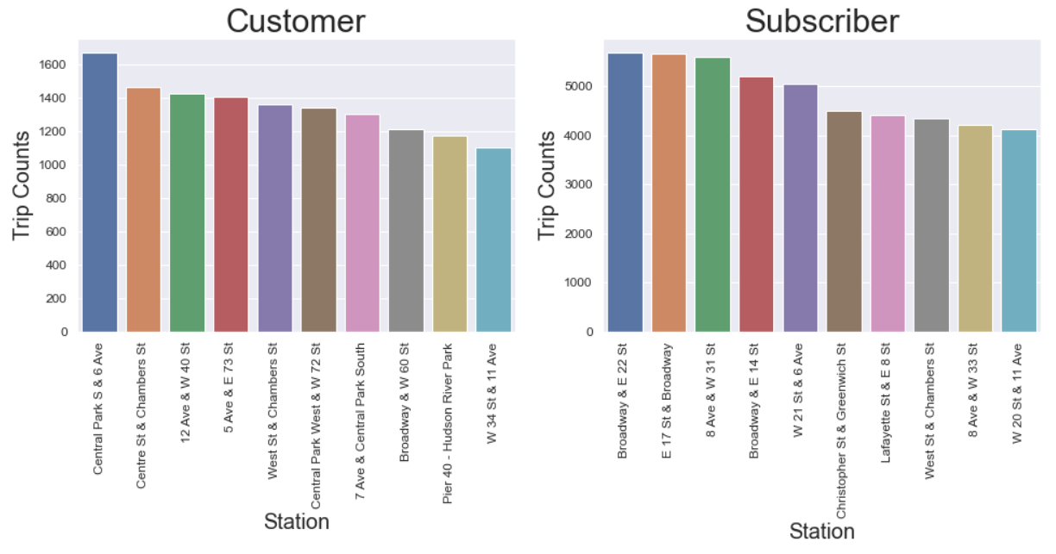
Most Popular Start Stations by User Type

Slide 14
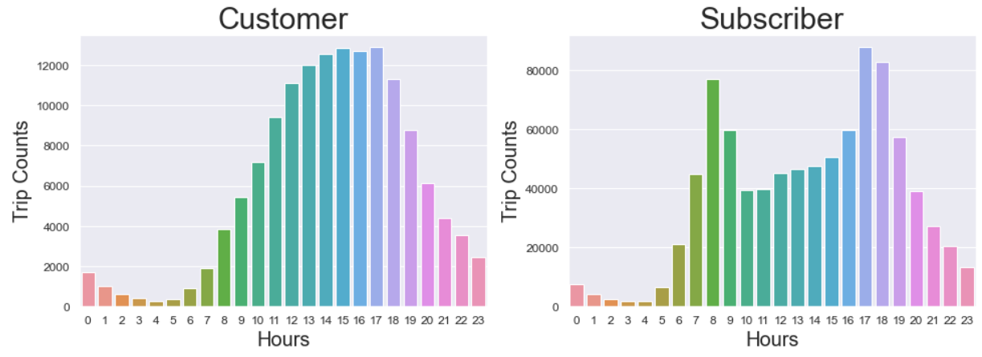
Most Popular Hours by User Type

Slide 15
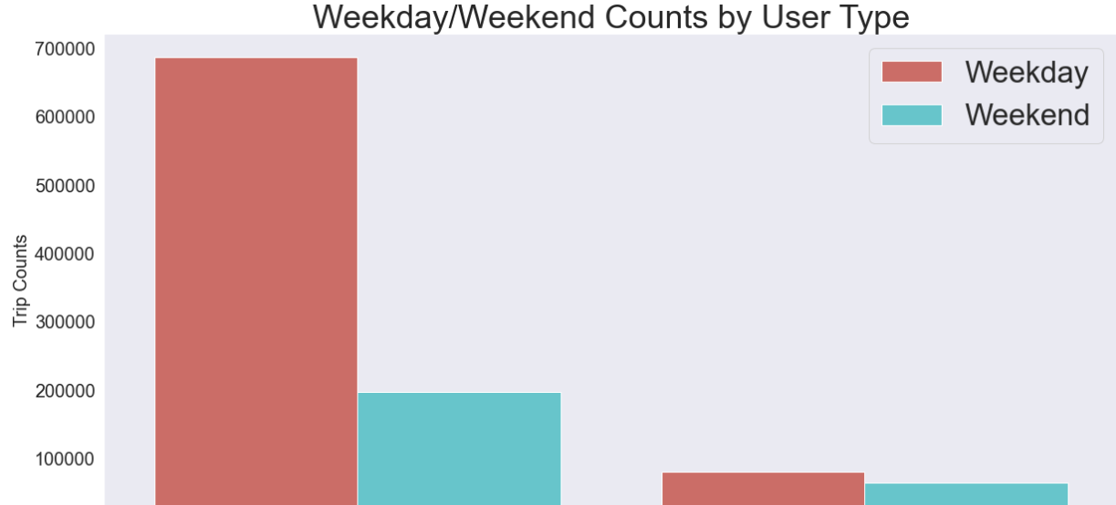

Slide 16
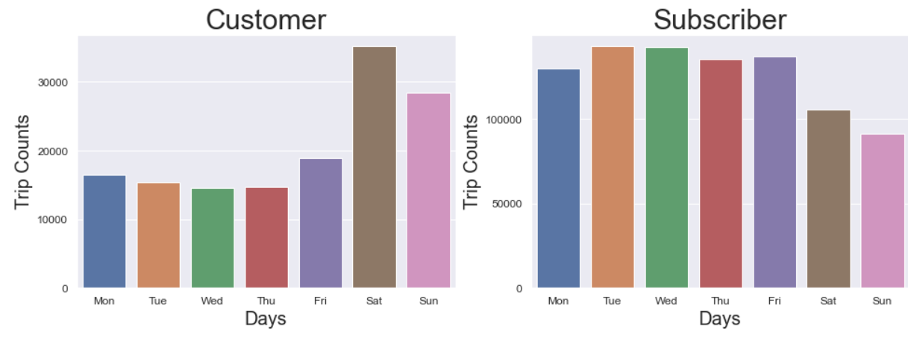
Most Popular Days of by User Type

Slide 17
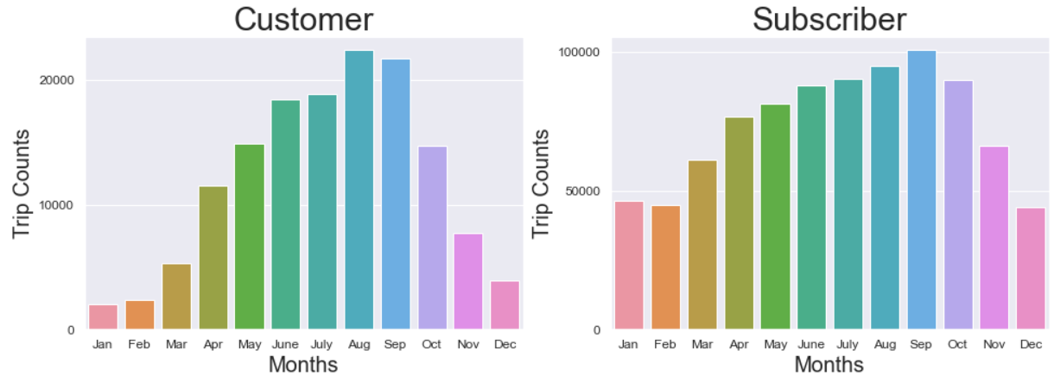
Most Popular Months by User Type

Slide 18
User Type Counts by
User Type

Slide 19
User Type Counts by
User Type

Slide 20
User Type Counts by
User Type

Slide 21
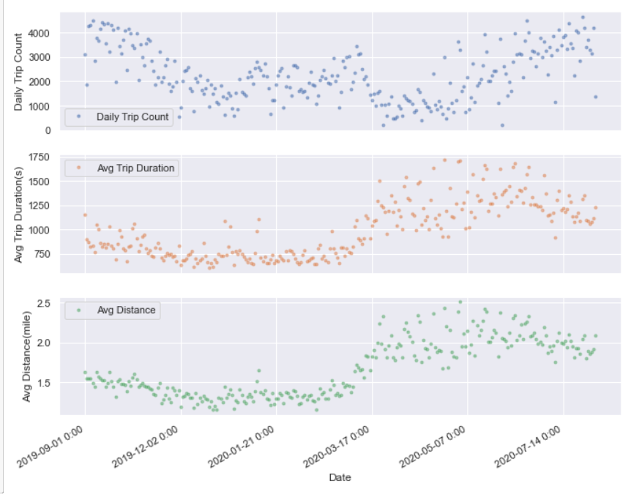
Seasonal Trend of Citi Bike Trips

Slide 22
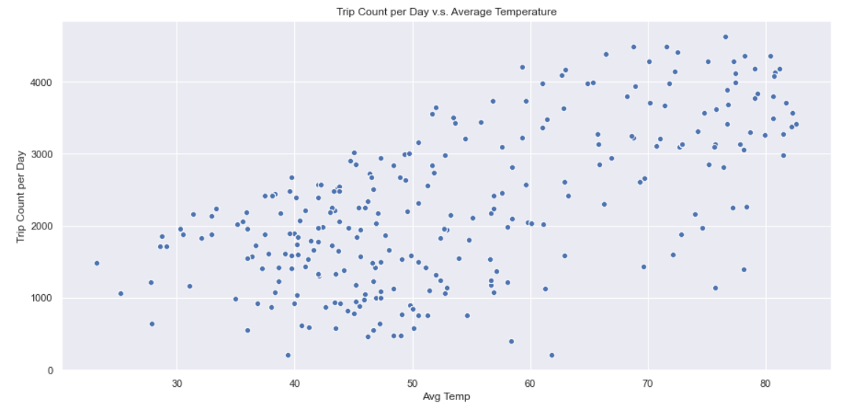
Temperature impact by ride counts

Slide 23
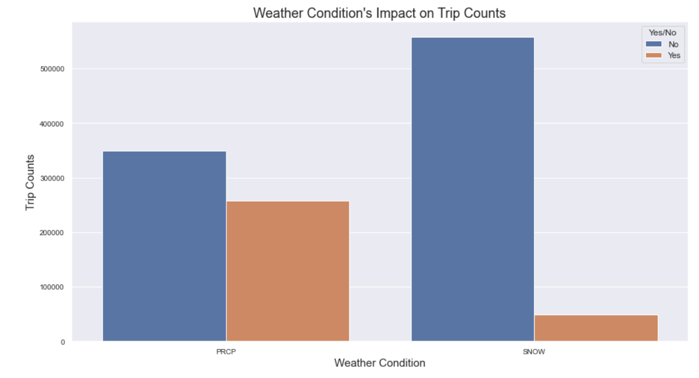
Weather Conditions impact by Ride Counts

Slide 24
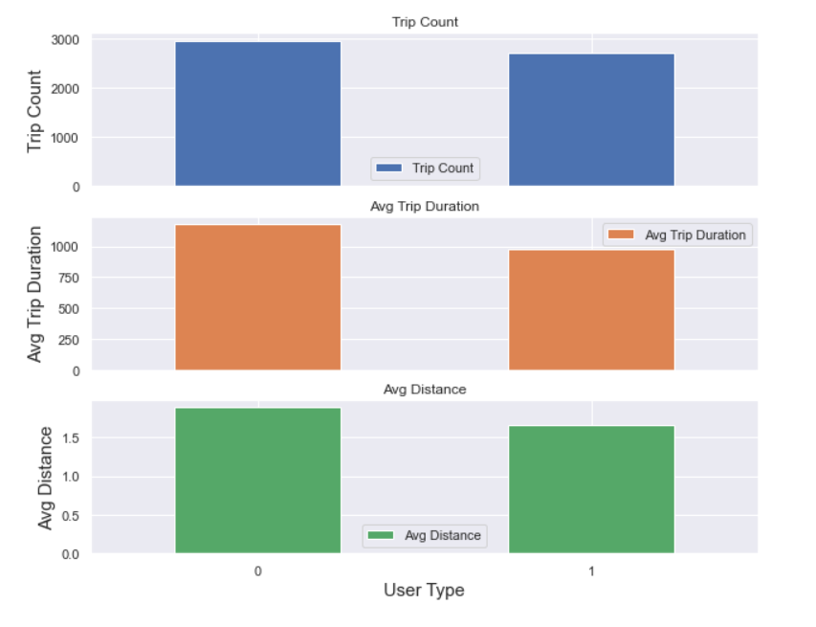
Ride by User Type
0 = Subscriber
1 = Customer

Slide 25
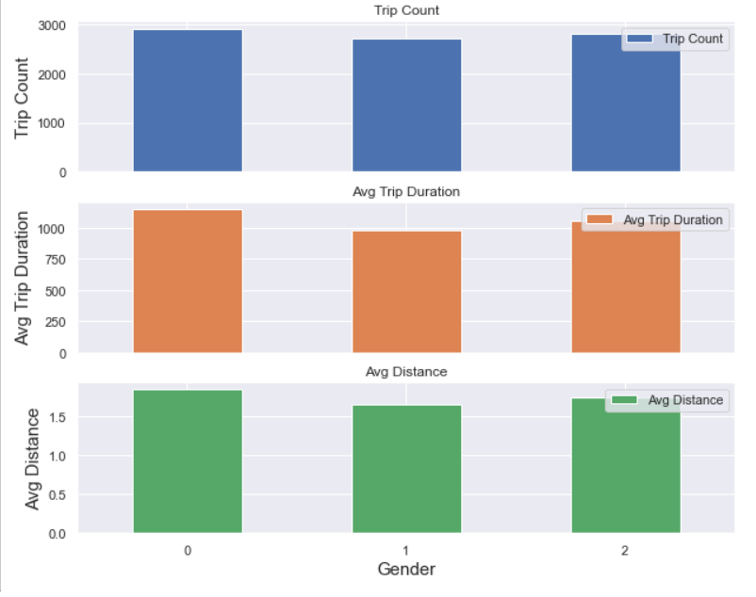
Ride by Gender
0=unknown;
1=male;
2=female

Slide 26
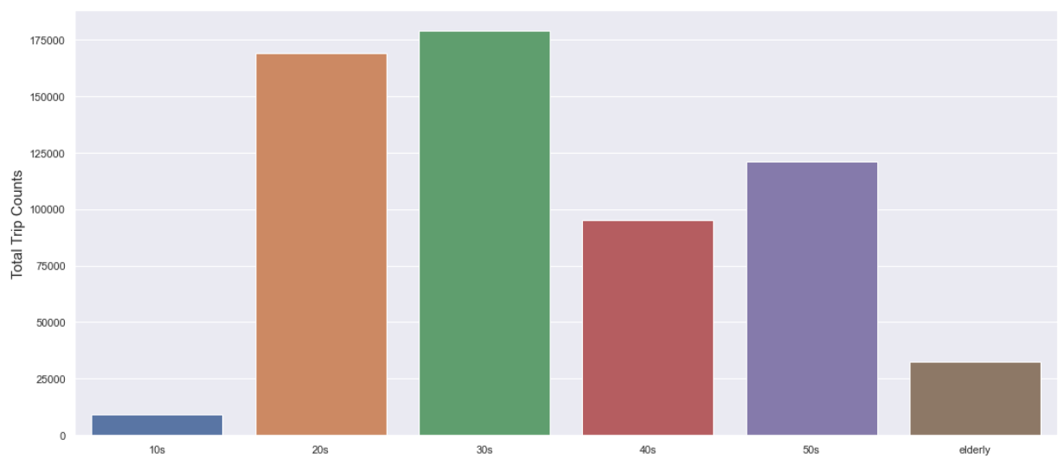
Ride by Ages

Slide 27
Target Variable
• start station checkout counts
Multiple Linear Regression, Ridge
• Model Accuracy: 77.97 % on test data

Slide 28
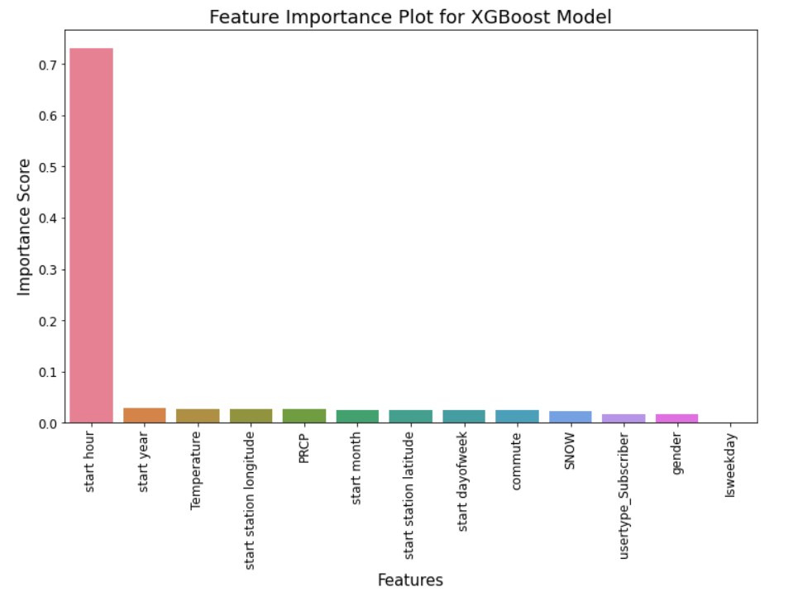
•Feature Importance
Start hour is excessively biased
• Test data 82.4 %

Slide 29
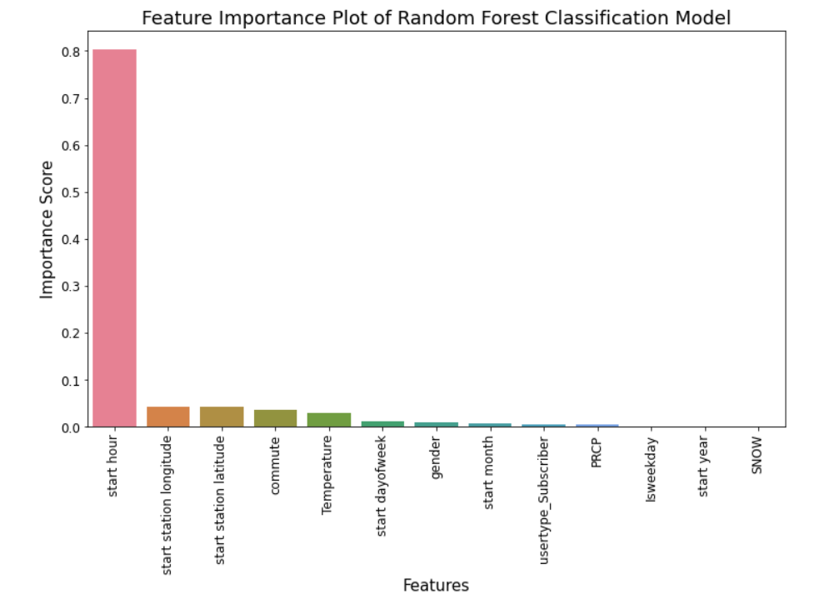
•Feature Importance
Start hour is excessively biased as well
Test data 84.0 %

Slide 30
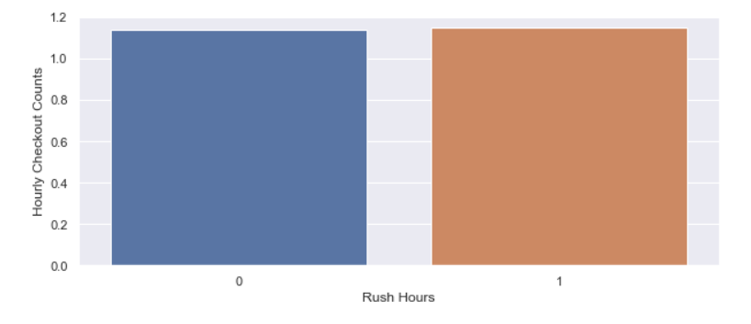
Rush Hours effect on Target Variable
[7, 8, 9, 16, 17, 18]

Slide 31
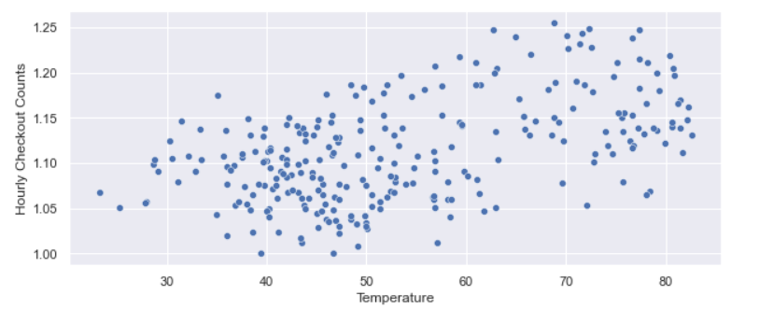
Temperature effect on
Target Variable

